Slide 1
Employee Data Analysis using Excel
STUDENT NAME: M.SUBARANJANI
REGISTER NO: 312216172
DEPARTMENT: BCOM BANK MANAGEMENT
COLLEGE: SHRI SHANKARLAL SUNDARBHAI SHASUN JAIN
COLLEGE FOR WOMENS

Slide 2
PROJECT TITLE
Employee Performance Analysis using Excel

Slide 3


AGENDA
Problem Statement
Project Overview
End Users
Our Solution and Proposition
Dataset Description
Modelling Approach
Results and Discussion
Conclusion
3/21/2024 Annual Review

Slide 4

PROBLEM STATEMENT
The current challenge is to effectively analyze employee performance data to enhance productivity and optimize organizational outcomes. However, the organization lacks a structured approach to measure, track, and analyze this data efficiently. Using Excel, the goal is to develop a systematic method to collect, organize, and analyze performance metrics, enabling us to identify key factors affecting employee performance, uncover patterns and trends, and generate clear, actionable insights.
This will help in making informed decisions to improve employee efficiency, target areas for training and development, and reduce turnover rates, all while maintaining a user-friendly and cost-effective analysis process.

Slide 5

PROJECT OVERVIEW
.
The Data Performance Analysis project using Excel aims to evaluate and enhance employee performance by leveraging data analysis tools available in Excel. This project involves gathering employee performance data, organizing it within Excel spreadsheets, and using various Excel functions and features—such as pivot tables, charts, and formulas—to analyze the data.
The objective is to identify key performance metrics, uncover trends, and generate visual reports that provide actionable insights. By utilizing Excel, the project focuses on making data analysis accessible and straightforward, enabling the organization to improve productivity, optimize employee development, and make
data-driven decisions to enhance overall business outcomes.

Slide 6


WHO ARE THE END USERS?
Human Resources (HR) Managers
Executives and Senior Management
Employees
Department Managers and Team Leaders
Data Analysts
Financial Analysts

Slide 7

OUR SOLUTION AND ITS VALUE PROPOSITION
Conditional Formatting: Highlights performance trends and anomalies with color-coded cells, making it easier to identify top performers and area sending improvement.
Filter by Color: If using conditional formatting, you can filter based on the colors applied to cells.
FORMULA :formulas can help you efficiently analyze employee performance data, track metrics, and generate meaningful insights.
PIVOT TABLE:A Pivot Table in Excel is a powerful tool that allows you to summarize, analyze, and visualize large datasets by reorganizing and aggregating data based on selected criteria. It enables quick analysis and reporting of data trends, comparisons, and insights by dragging and dropping fields into rows, columns, and values.

Slide 8
Dataset Description
EMPLOYE DATASET-thespreadsheetguru
Employee Performance Analysis - 7 Features :
Employee Id - Numeric
Name -Text
Business Unit - R&D , Corporate..,Etc.
Department - IT , Finance, etc.
Gender - Female , Male
Performance Score - High, Low , Mid
Annual Salary - Numeric
Bonus - Numeric

Slide 9

THE "WOW" IN OUR SOLUTION
PERFORMANCE LEVEL: Analyzing performance data in Excel using array formula and dynamic range name methods. The recording and analysis of performance data is the quintessential spreadsheet application. FORMULA: =IFS(I8>=5,"Veryhigh",J8>=4,"High",J8>=3,"Med",TRUE,"LOW")
REPT FUNCTION:
Analyzing performance data in Excel using array formula and dynamic range name methods. The recording and analysis of performance data is the quintessential spreadsheet application.
FORMULA: =REPT("I",J1*100)
3/21/2024 Annual Review
9

Slide 10
MODELLING
Data Collection: We compile employee data from various sources, such as HR systems, performance reviews, attendance records, and training logs. This data is centralized in Excel to ensure easy access and consistency.
Data Organization: Data is organized into structured Excel sheets and tables, categorizing information into different sections like personal details, performance metrics, attendance records, and training history. This ensures data is well-organized and easily navigable.
Data Validation: We implement data validation rules to maintain data accuracy, ensuring entries are consistent and free from errors. This includes restricting inputs to predefined options (e.g., department names) and validating numerical entries (e.g., scores within a certain range).
Data Cleaning: Automated processes remove duplicates, fill in missing values, and standardize data formats (e.g., dates), ensuring that the data used for analysis is reliable and accurate.
10

Slide 11
MODELLING CONTD…
KPIs: Define and calculate Key Performance Indicators (KPIs) such as average performance scores, percent completion of goals, and attendance rates using formulas.
Custom Metrics: Develop custom metrics that align with your organization’s performance evaluation criteria.
Pivot Tables: Use Pivot Tables to summarize and analyze performance data by various dimensions such as departments, roles, or time periods.
Formulas: Apply Excel formulas to calculate aggregate metrics, trends, and comparisons (e.g., AVERAGE, SUMIF, COUNTIF).
What-If Analysis: Utilize Excel’s data analysis tools (e.g., Scenario Manager, Data Tables) to explore different performance scenarios and their potential impact.
Trend Analysis: Analyze historical performance data to identify trends and predict future performance outcomes.
Automated Reports: Create automated report templates to summarize performance findings, highlight key metrics, and generate periodic performance summaries.
Custom Reports: Develop tailored reports for specific stakeholders, such as detailed departmental performance reviews or executive summaries.

Slide 12
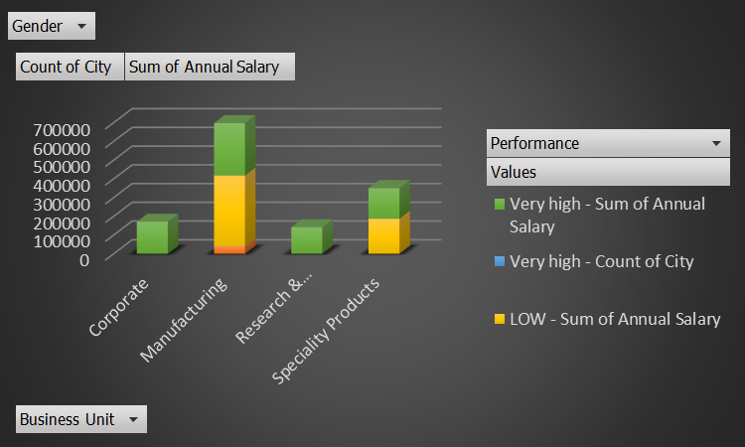
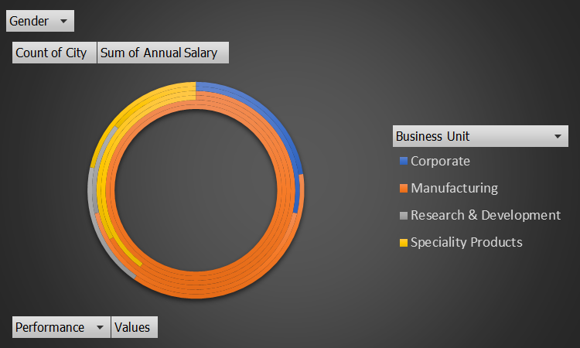
RESULTS
The results of the Employee Performance Analysis using Excel demonstrate a significant positive impact on both individual and organizational performance. By leveraging Excel's capabilities for data management, analysis, and visualization, the organization has achieved greater transparency, efficiency, and strategic alignment. This data-driven approach has empowered decision-makers, improved employee engagement, and fostered a culture of continuous improvement, positioning the organization for sustained success.
12

Slide 13
conclusion
Our solution for Employee Performance Analysis using Excel is designed to provide comprehensive, actionable insights into employee performance. By leveraging Excel’s powerful data management, analysis, and visualization tools, we help organizations optimize employee performance, enhance productivity, and achieve strategic objectives. This solution empowers decision-makers with the information they need to foster a culture of continuous improvement and data-driven decision-making.

